Slide 1

Design change on the Udacity website: Testing if the new feature improves user experience and elevates retention

Slide 2
BACKGROUND
BUSINESS CONTEXT
CAUSAL
QUESTION
IMPORTANCE
Udacity is an educational organization offering massive open online courses.
It has invested heavily in the course content, leaving the design team with sparse resources for quantitative data-driven decisions
The design team wants to assess if a proposed new feature improves user experience and elevates retention
It is useful to understand the causal impact of this design feature, because this design feature is intended to increase positive customer experience and bring in more revenue per user who enrols for free trial

Slide 3

EXISTING USER FLOW [CONTROL]
OPTION 1
Access Free Course Materials
OPTION 2
Start Free Trial
Enter Credit Card Info
Videos √
Quizzes √
Coaching √
Certificate √
END OF FLOW

Slide 4
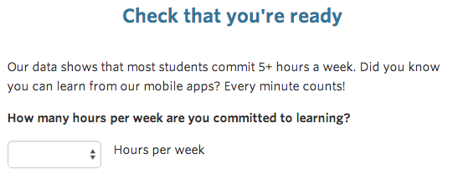
PROPOSED NEW FEATURE [TREATMENT]
OPTION 1
Access Free Course Materials
OPTION 2
Start Free Trial
< 5 Hours
>= 5 Hours
Precautionary Message
Usual Checkout Process
END OF FLOW

Slide 5
1
Threats to Causal Inference

Slide 6
The profitability is determined by initial investment in purchasing properties, as well as the subsequent returns from renting that property
NO BASELINE FOR BENCHMARKING
Since we do not have data of any other online teaching platform as our baseline, it’s possible that we overestimate the influence of this experiment.
1
INTERFERENCE
Even though the experiments are randomized, the users who are a part of the experiment might know each other. The behavior of people towards the experiments might deviate from natural free choice in that case
2
MEASUREMENT
ERROR
Some users may pay for the courses after free trial if they forget to cancel the enrollment. This might lead to measurement error of one of our independent variables, which is enrollment.
3
OMITTED VARIABLE
There might be other unaccounted variables which influence the three performance evaluation metrics, for example inequitable exposure of test and control populations to some advertising campaigns run by Udacity
4

Slide 7
2
Analysis of Experiment
DATASET/
MEASURES
METHODS:
CAUSAL ANALYSIS
RESULTS
IMPLICATIONS

Slide 8
DATASET/
MEASURES
METHODS:
CAUSAL ANALYSIS
RESULTS
IMPLICATIONS
Considering the limited budget, the Facebook’s Atlas platform only gives visibility to five attributes, for measuring the efficacy of our experiment
DESCRIPTION
TYPE
DATE
Date the data is recorded
Date
PAGE VIEWS
Number of unique users to view the course overview page that day
Numeric
CLICKS
Number of unique users to click the course overview page that day
Numeric
ENROLLMENTS
Number of user-ids to enroll in the free trial that day
Numeric
PAYMENTS
Number of user-ids who enrolled on that day to remain enrolled for 14 days and thus make a payment
Numeric

Slide 9
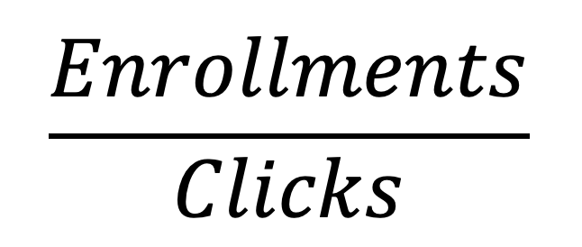
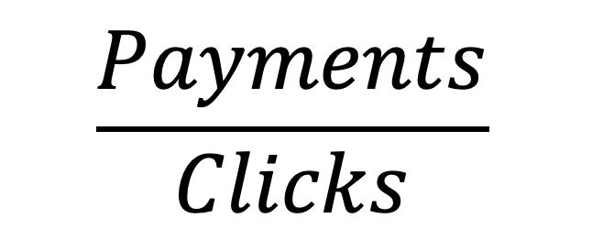
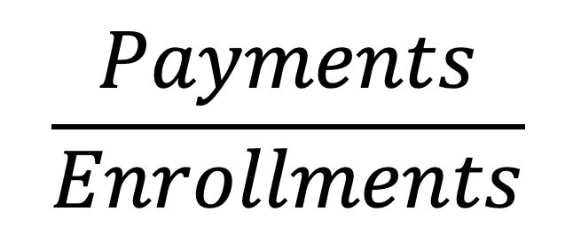
DATASET/
MEASURES
METHODS:
CAUSAL ANALYSIS
RESULTS
IMPLICATIONS
We are considering three evaluation metrics to get a holistic read on the effects of the experiment
DESCRIPTION
GROSS CONVERSION
NET CONVERSION
RETENTION

Slide 10
DATASET/
MEASURES
METHODS:
CAUSAL ANALYSIS
RESULTS
IMPLICATIONS
Methods employed in the quantitative analysis
RANDOMIZATION CHECK
Is the treatment and control population truly randomized for the experiment? (This task was performed by a black-box model in Atlas platform)
1
POWER TEST
2
How much data is required?
TEST FOR CAUSALITY
Does the new feature significantly affect our evaluation metrics (metrics where we expect change)?
3

Slide 11
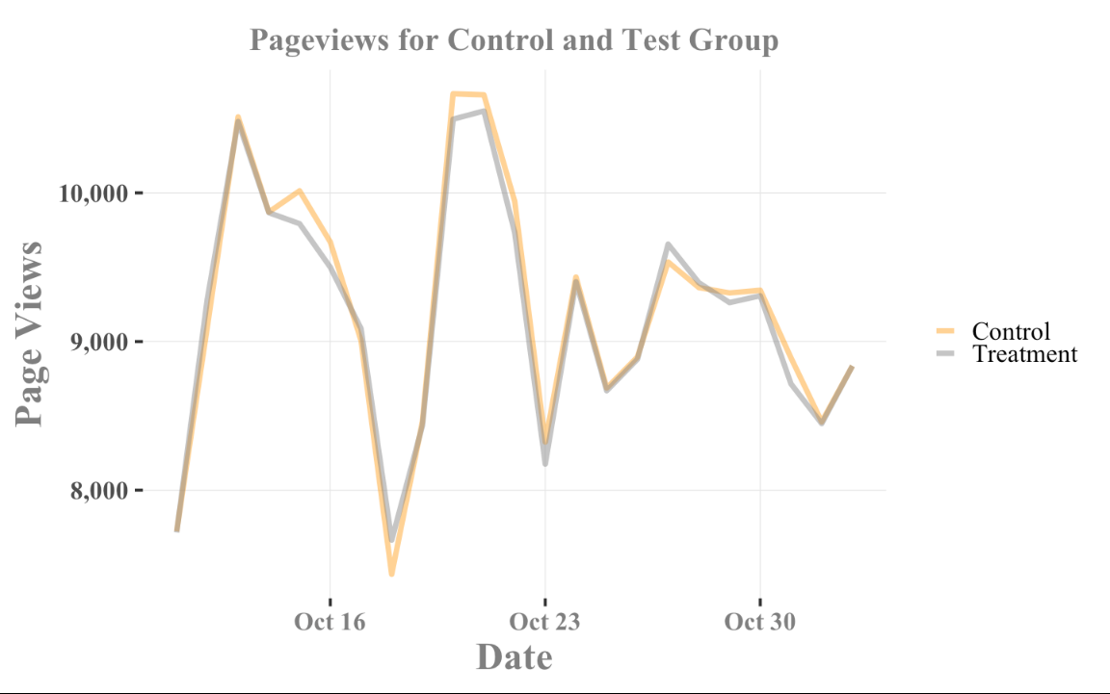
DATASET/
MEASURES
METHODS:
CAUSAL ANALYSIS
RESULTS
IMPLICATIONS
Randomization Check to assess if the Daily Page Views on Udacity website are invariant between Test and Control Group
P value from T-Test: 0.887
Since this is >0.05, it implies that there is no evidence for difference in Page Views, between Test and Control groups
Notes:
# PAGE VIEWS
base_size<-25
ggplot(data, aes(Date, Pageviews, col = Treatment)) +
geom_line(alpha=0.5,size=2)+
#scale_fill_brewer(palette="Set2")+
scale_colour_manual("legend", values = c('Control' = "orange", 'Treatment' = "grey53"))+
#scale_colour_manual(values = c("darkblue","red"))+
xlab('Date') +
ylab('Page Views') +
ggtitle('Pageviews for Control and Test Group')+
theme(plot.title = element_text(size=22),
axis.title.x = element_text(size=14),
axis.title.y = element_text(size=14),
legend.title = element_text(size=14))+
scale_y_continuous(labels = comma)+
theme_tufte(base_size = base_size,base_family = "Times New Roman")+
theme(
plot.title = element_text(hjust=0.5,size = base_size *1,face="bold",margin=margin(10,0,10,0),colour = "grey50"),
plot.subtitle=element_text(face="bold.italic",size = base_size *1.3,colour="grey40"),
#plot.caption=element_text(hjust=1,size=9,colour="grey30"),
panel.grid.major = element_line(colour="grey90",size=0.35),
#legend.title=element_text(size = base_size *1.2,face="bold",colour = "grey50"),
legend.position="right",
legend.title=element_blank(),
axis.title.x = element_text(size = base_size *1.2,face = "bold",colour = "grey50"),
axis.title.y = element_text(size = base_size *1.2,face = "bold",colour = "grey50"),
axis.text.x = element_text(size = base_size *0.8,face = "bold",colour = "grey50"),
axis.text.y = element_text(size = base_size *0.8,face = "bold"),)

Slide 12
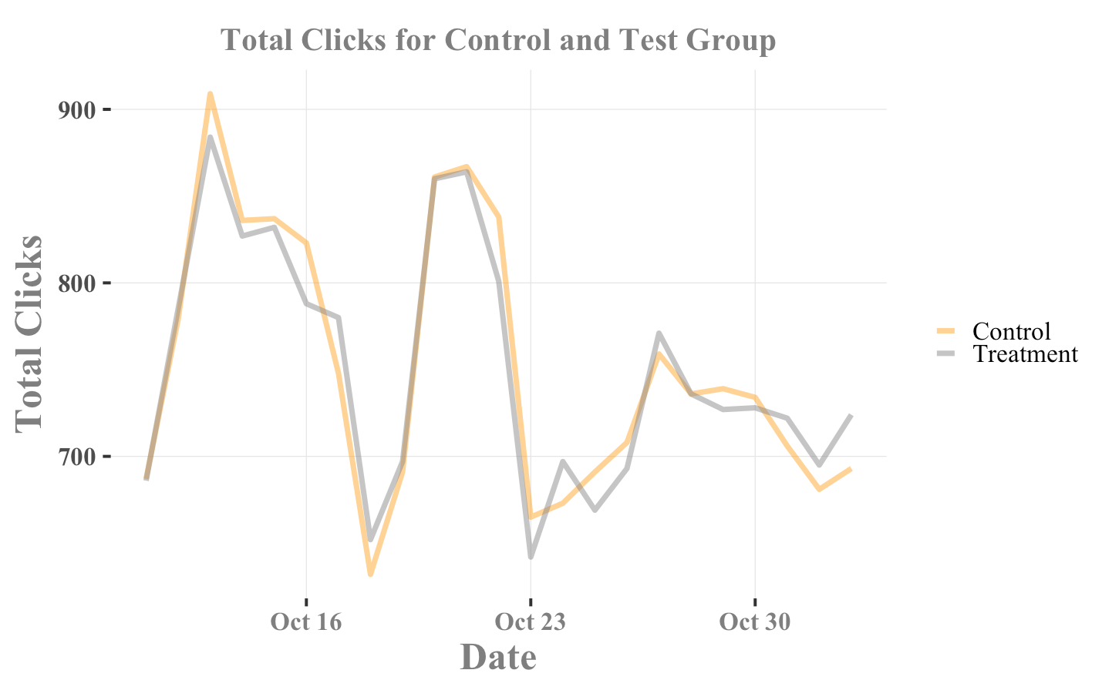
DATASET/
MEASURES
METHODS:
CAUSAL ANALYSIS
RESULTS
IMPLICATIONS
Randomization Check to assess if the Daily User Clicks on Udacity website are invariant between Test and Control Group
P value from T-Test: 0.9477
Since this is >0.05, it implies that there is no evidence for difference in Page Views, between Test and Control groups
Notes:
base_size<-25
ggplot(data, aes(Date, Clicks, col = Treatment)) +
geom_line(alpha=0.5,size=2)+
#scale_fill_brewer(palette="Set2")+
scale_colour_manual("legend", values = c('Control' = "orange", 'Treatment' = "grey53"))+
#scale_colour_manual(values = c("darkblue","red"))+
xlab('Date') +
ylab('Total Clicks') +
ggtitle('Total Clicks for Control and Test Group')+
theme(plot.title = element_text(size=22),
axis.title.x = element_text(size=14),
axis.title.y = element_text(size=14),
legend.title = element_text(size=14))+
scale_y_continuous(labels = comma)+
theme_tufte(base_size = base_size,base_family = "Times New Roman")+
theme(
plot.title = element_text(hjust=0.5,size = base_size *1,face="bold",margin=margin(10,0,10,0),colour = "grey50"),
plot.subtitle=element_text(face="bold.italic",size = base_size *1.3,colour="grey40"),
#plot.caption=element_text(hjust=1,size=9,colour="grey30"),
panel.grid.major = element_line(colour="grey90",size=0.35),
#legend.title=element_text(size = base_size *1.2,face="bold",colour = "grey50"),
legend.position="right",
legend.title=element_blank(),
axis.title.x = element_text(size = base_size *1.2,face = "bold",colour = "grey50"),
axis.title.y = element_text(size = base_size *1.2,face = "bold",colour = "grey50"),
axis.text.x = element_text(size = base_size *0.8,face = "bold",colour = "grey50"),
axis.text.y = element_text(size = base_size *0.8,face = "bold"),)

Slide 13
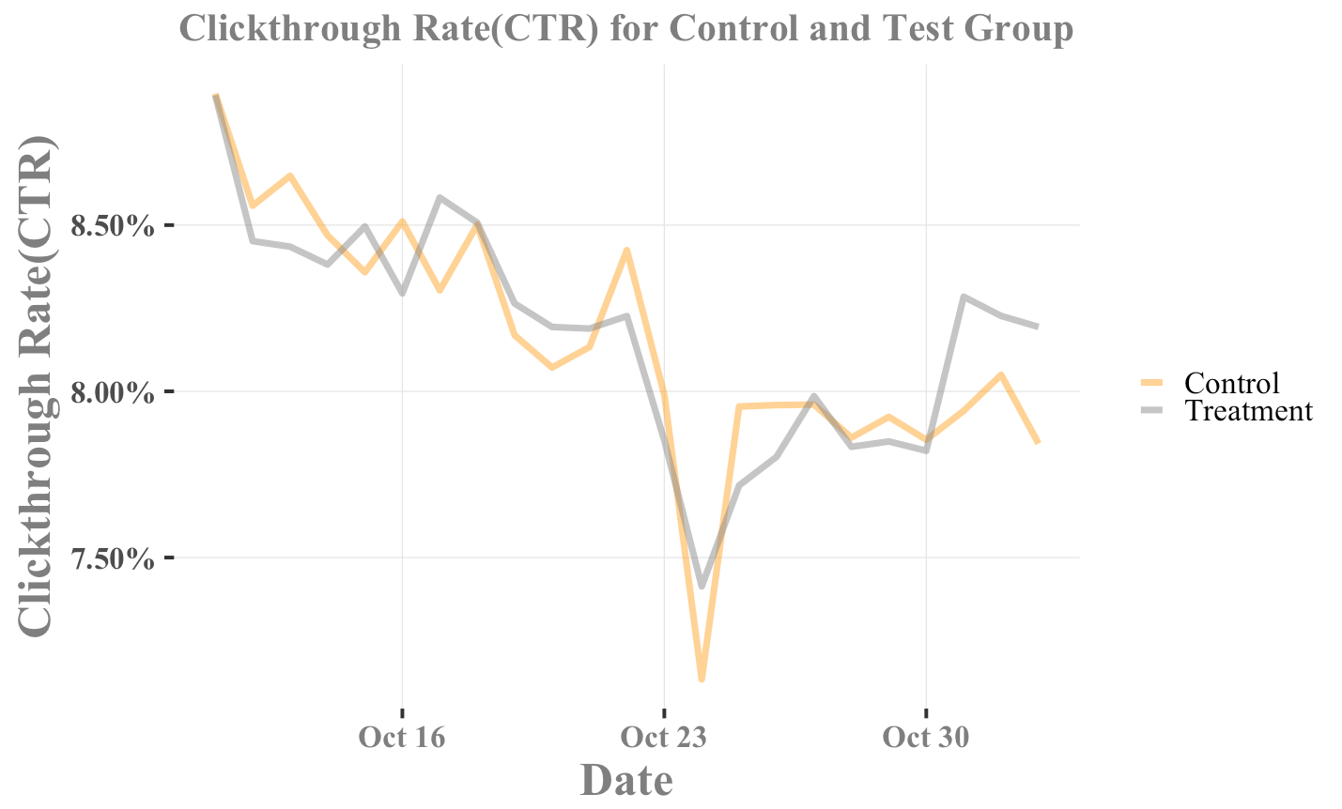
DATASET/
MEASURES
METHODS:
CAUSAL ANALYSIS
RESULTS
IMPLICATIONS
Randomization Check to assess if the Daily Click-through Rate (CTR) on Udacity website are invariant between Test and Control Group
P value from T-Test: 0.8753
Since this is >0.05, it implies that there is no evidence for difference in Page Views, between Test and Control groups
Notes:
base_size<-25
ggplot(data, aes(Date, click_through_rate, col = Treatment)) +
geom_line(alpha=0.5,size=2)+
#scale_fill_brewer(palette="Set2")+
scale_colour_manual("legend", values = c('Control' = "orange", 'Treatment' = "grey53"))+
#scale_colour_manual(values = c("darkblue","red"))+
xlab('Date') +
ylab('Clickthrough Rate(CTR)') +
ggtitle('Clickthrough Rate(CTR) for Control and Test Group')+
theme(plot.title = element_text(size=22),
axis.title.x = element_text(size=14),
axis.title.y = element_text(size=14),
legend.title = element_text(size=14))+
#scale_y_continuous(labels = comma)+
scale_y_continuous(labels = scales::percent)+
theme_tufte(base_size = base_size,base_family = "Times New Roman")+
theme(
plot.title = element_text(hjust=0.5,size = base_size *1,face="bold",margin=margin(10,0,10,0),colour = "grey50"),
plot.subtitle=element_text(face="bold.italic",size = base_size *1.3,colour="grey40"),
#plot.caption=element_text(hjust=1,size=9,colour="grey30"),
panel.grid.major = element_line(colour="grey90",size=0.35),
#legend.title=element_text(size = base_size *1.2,face="bold",colour = "grey50"),
legend.position="right",
legend.title=element_blank(),
axis.title.x = element_text(size = base_size *1.2,face = "bold",colour = "grey50"),
axis.title.y = element_text(size = base_size *1.2,face = "bold",colour = "grey50"),
axis.text.x = element_text(size = base_size *0.8,face = "bold",colour = "grey50"),
axis.text.y = element_text(size = base_size *0.8,face = "bold"),)

Slide 14
What does this mean?
We have successfully performed the sanity checks, to assess if the test and control groups are not inherently biased in terms of randomization

Slide 15
DATASET/
MEASURES
METHODS:
CAUSAL ANALYSIS
RESULTS
IMPLICATIONS
Randomization Check to assess if the Daily Click-through Rate (CTR) on Udacity website are invariant between Test and Control Group
STATISTICALLY SIGNIFICANT DIFFERENCE BETWEEN TEST AND CONTROL POPULATION?
GROSS CONVERSION
YES
NET CONVERSION
NO
RETENTION
NO

Slide 16
What does this mean?
A statistically and practically significant decrease in Gross Conversion was observed but with no significant differences in Net Conversion.
This translates to a decrease in enrollment not coupled to an increase in students staying for the requisite 14 days to trigger payment

Slide 17
DATASET/
MEASURES
METHODS:
CAUSAL ANALYSIS
RESULTS
IMPLICATIONS
Deeper Dive into how the Gross conversion metric is being affected by the experiment
Gross Conversion
VARIABLE | COEFFICIENT | SIGNIFICANCE
Treatment | - 0.019 | Significant
Pageviews | 0.000084 | Very Significant
Clicks | - 0.0011 | Very Significant
Weekend | - 0.0031 | Not significant
Interpretation: The treatment group tends to have 0.019 decrease in gross conversion compared with control group.

Slide 18
DATASET/
MEASURES
METHODS:
CAUSAL ANALYSIS
RESULTS
IMPLICATIONS
Power Test for sample size
Metrics | Baseline | Required Detectable Change | Required Data Size
Gross Conversion | 0.20625 | 1% change | 6278 days
Net Conversion | 0.53 | 1% change | 5540 days
Retention | 0.109313 | 0.75% change | 17201 days
Reality -
Only have 23-day data!

Slide 19
3
Limitations and
Recommendations

Slide 20
The experiment has multiple limitations, which can be addressed to some degree with a higher budget allocation for tracking clickstream data
DURATION
OF EXPERIMENT
Data is available for a month. It may be insufficient to establish a measure of success (causal relationship) with strong certainty
1
We are missing customer attribute information. As such, even if the treatment yields an overall positive effect, we do not know if it has a negative outcome on a certain section of users.
In other words, there is no way to breakdown the analysis by customer segments and observe the variation in each segment
SECOND
ORDER EFFECTS
2
By showing a calculated warning to a section of users in the test group, and not to the control group, we are revealing more information to them in order to decide.
This is putting the users in the control group at a disadvantage. Informed consent has also not been taken from users.
ETHICAL
CONSIDERATIONS
3

Slide 21
Recommendations to the executive team
DEEP DIVE INTO USER JOURNEY DURING FREE TRIAL
A successful experiment would be one in which there is a signficant decrease in Gross Conversion coupled to a significant increase in Net Conversion.
Additional deep dive analysis into user journey during free trial, may give insights into required invention for improving retention
1
INVEST MORE RESOURCES FOR USER LEVEL ATTRIBUTES
Facebook’s ATLAS platform can provide access to additional user level information, with a premium access
With more resources, the experiment should be run for a longer duration to pick up stabilized effect of the new feature
Access to new variables can also allow study into the people who entered <5 hours Vs. >=5 hrs
2

